Slide 1
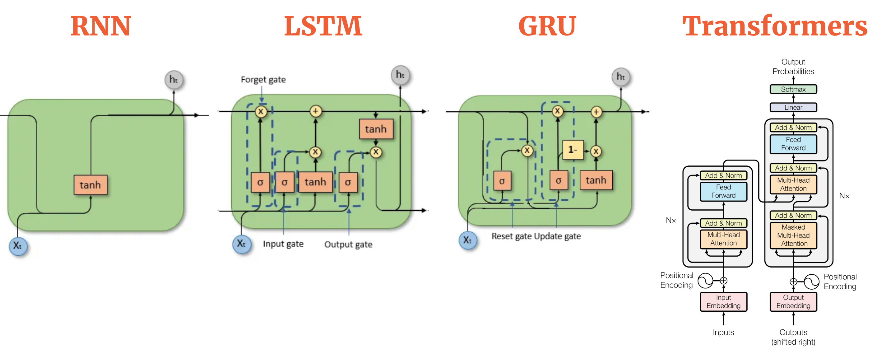

Slide 2
LLMs
Large Language Models are deep learning models that utilize neural network architectures to understand, process, and generate human-like text.
They are trained on large datasets using techniques like unsupervised learning, where they learn to predict the next word in a sequence of text given the previous context.
LLMs are often based on architectures like Transformer, LSTM (Long Short-Term Memory), or similar recurrent or attention-based models.

Slide 3
Use Case
Language Translation
Text Generation
Text Completion
Language Classification
Summarization

Slide 4
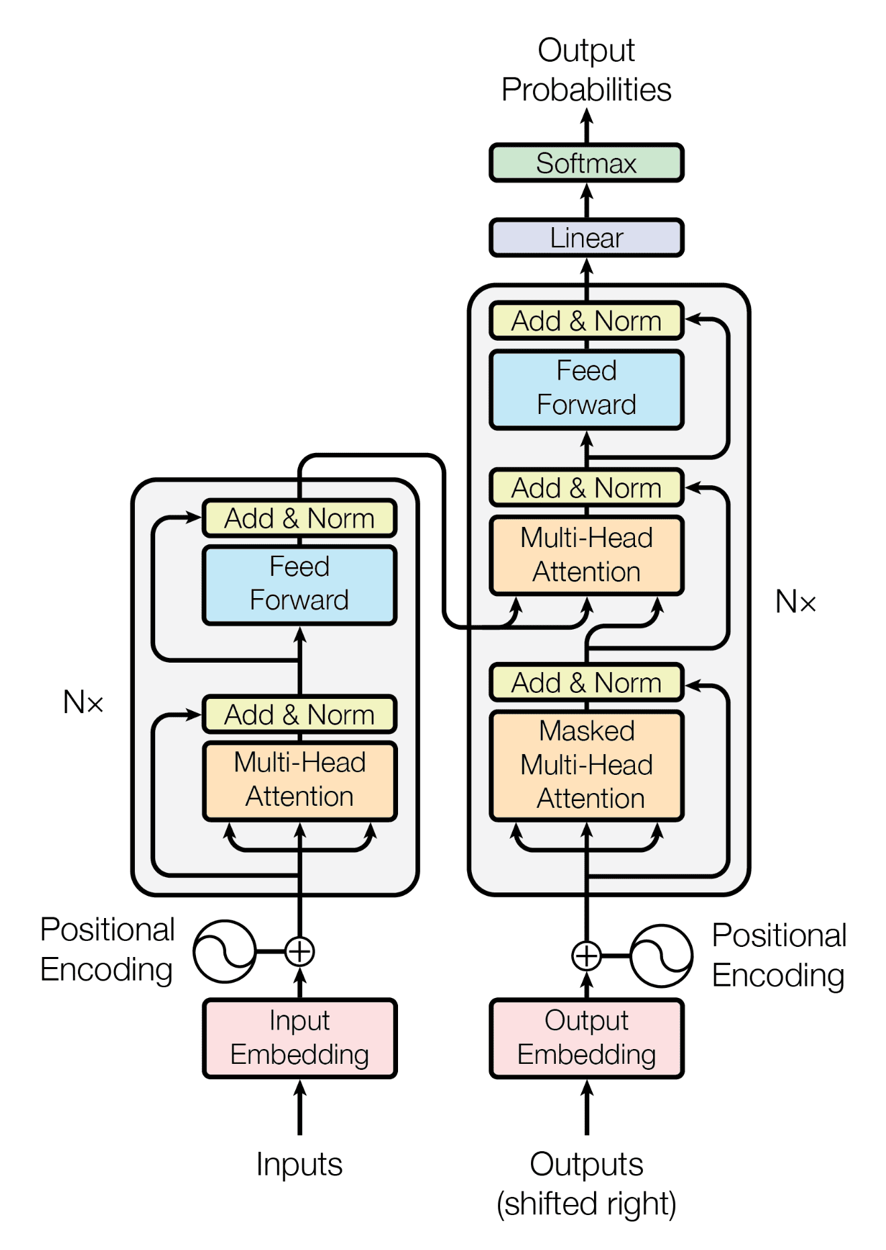
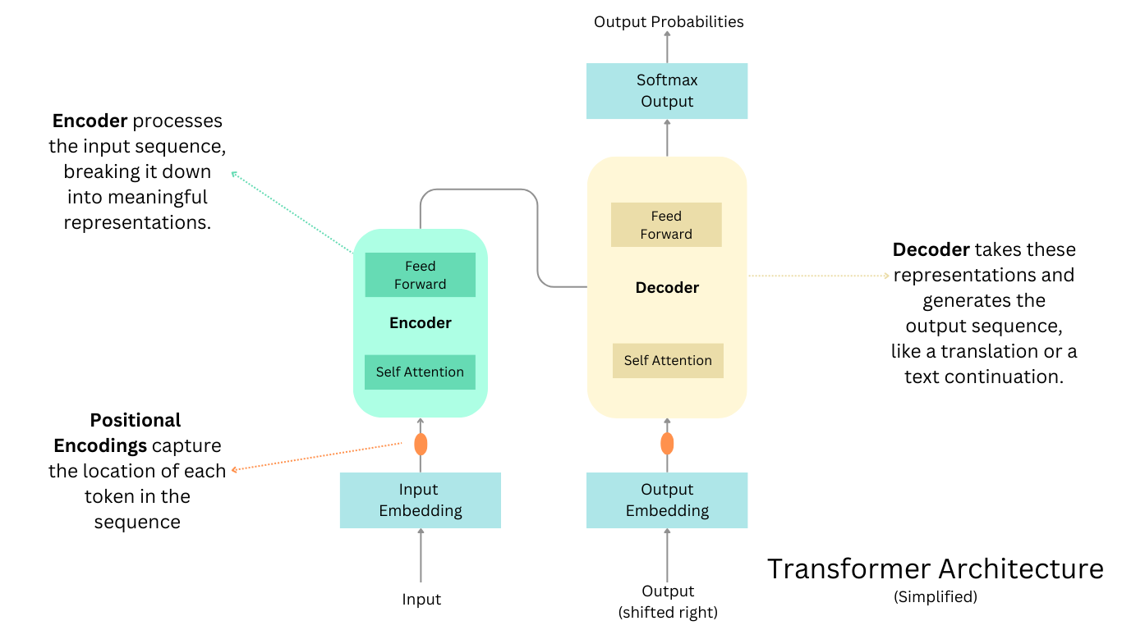
Transformers

Slide 5
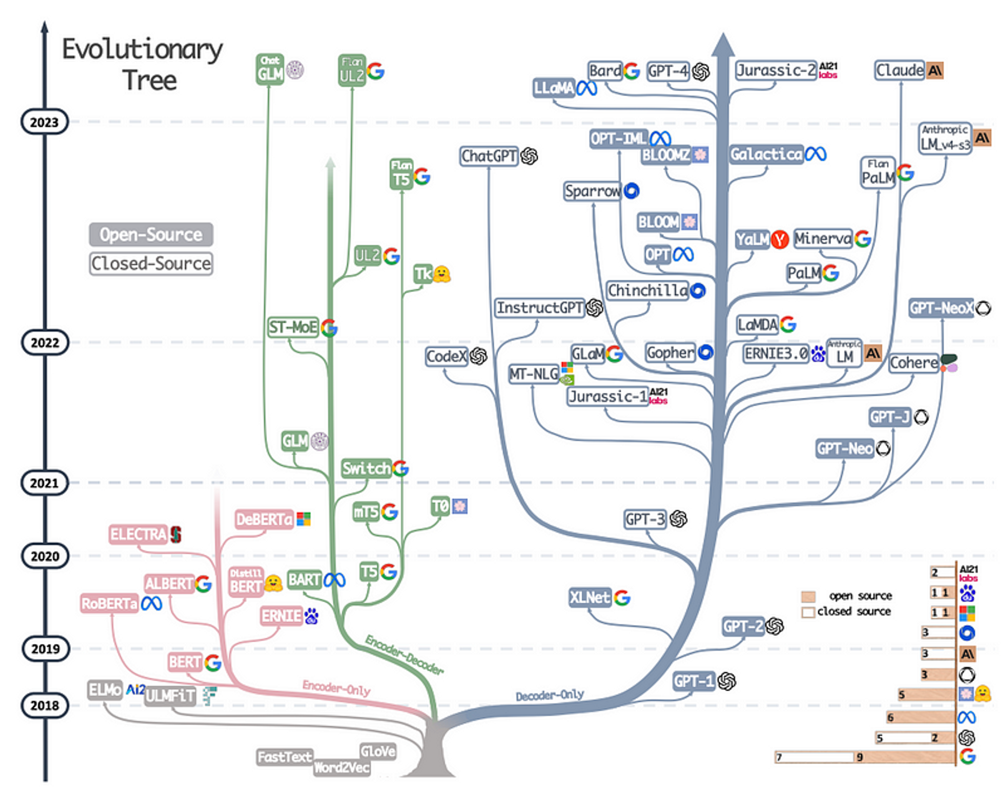
Family Of LLMs

Slide 6
Encoder only: Understand sentiment analysis, classification
Encoder-decoder: Understand and write, Summarization/language translation
Decoder: write only Text completion

Slide 7

Hugging Face
Hugging Face (HF) is a company that provides artificial intelligence (AI) researchers, developers, and enthusiasts with the tools and resources they need to use, build and share machine learning (ML) models.

Slide 8
Demo
https://huggingface.co/Bibek1129

Slide 9
Nepali Poem Generation
https://github.com/HordesOfGhost/Nepali_Poem_Generator/tree/main
https://medium.com/ai-in-plain-english/create-your-own-nepali-poem-generation-model-1575e56eb690

